Slide 1

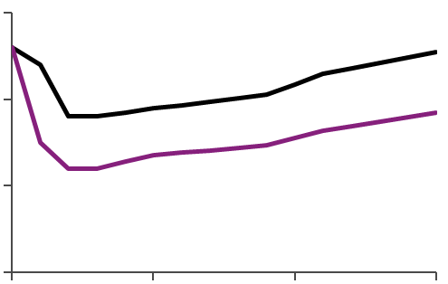
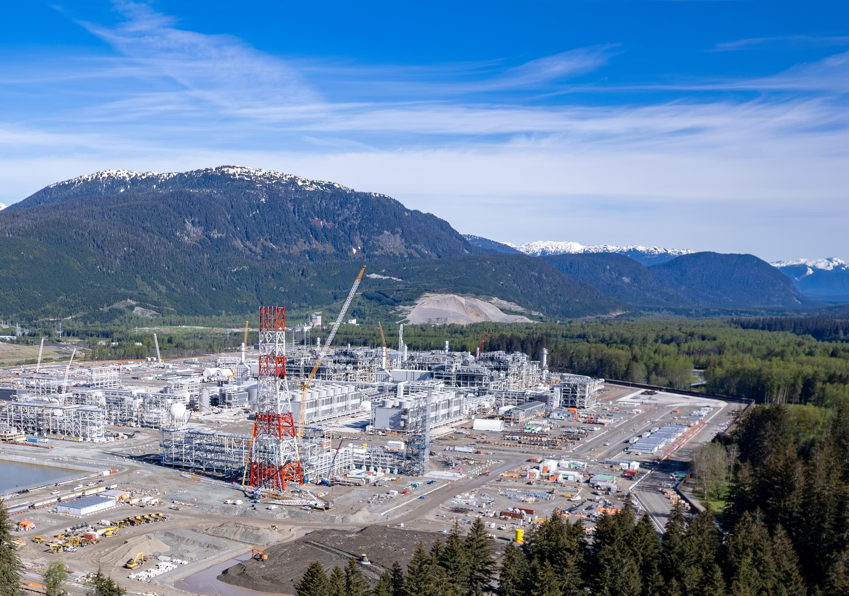
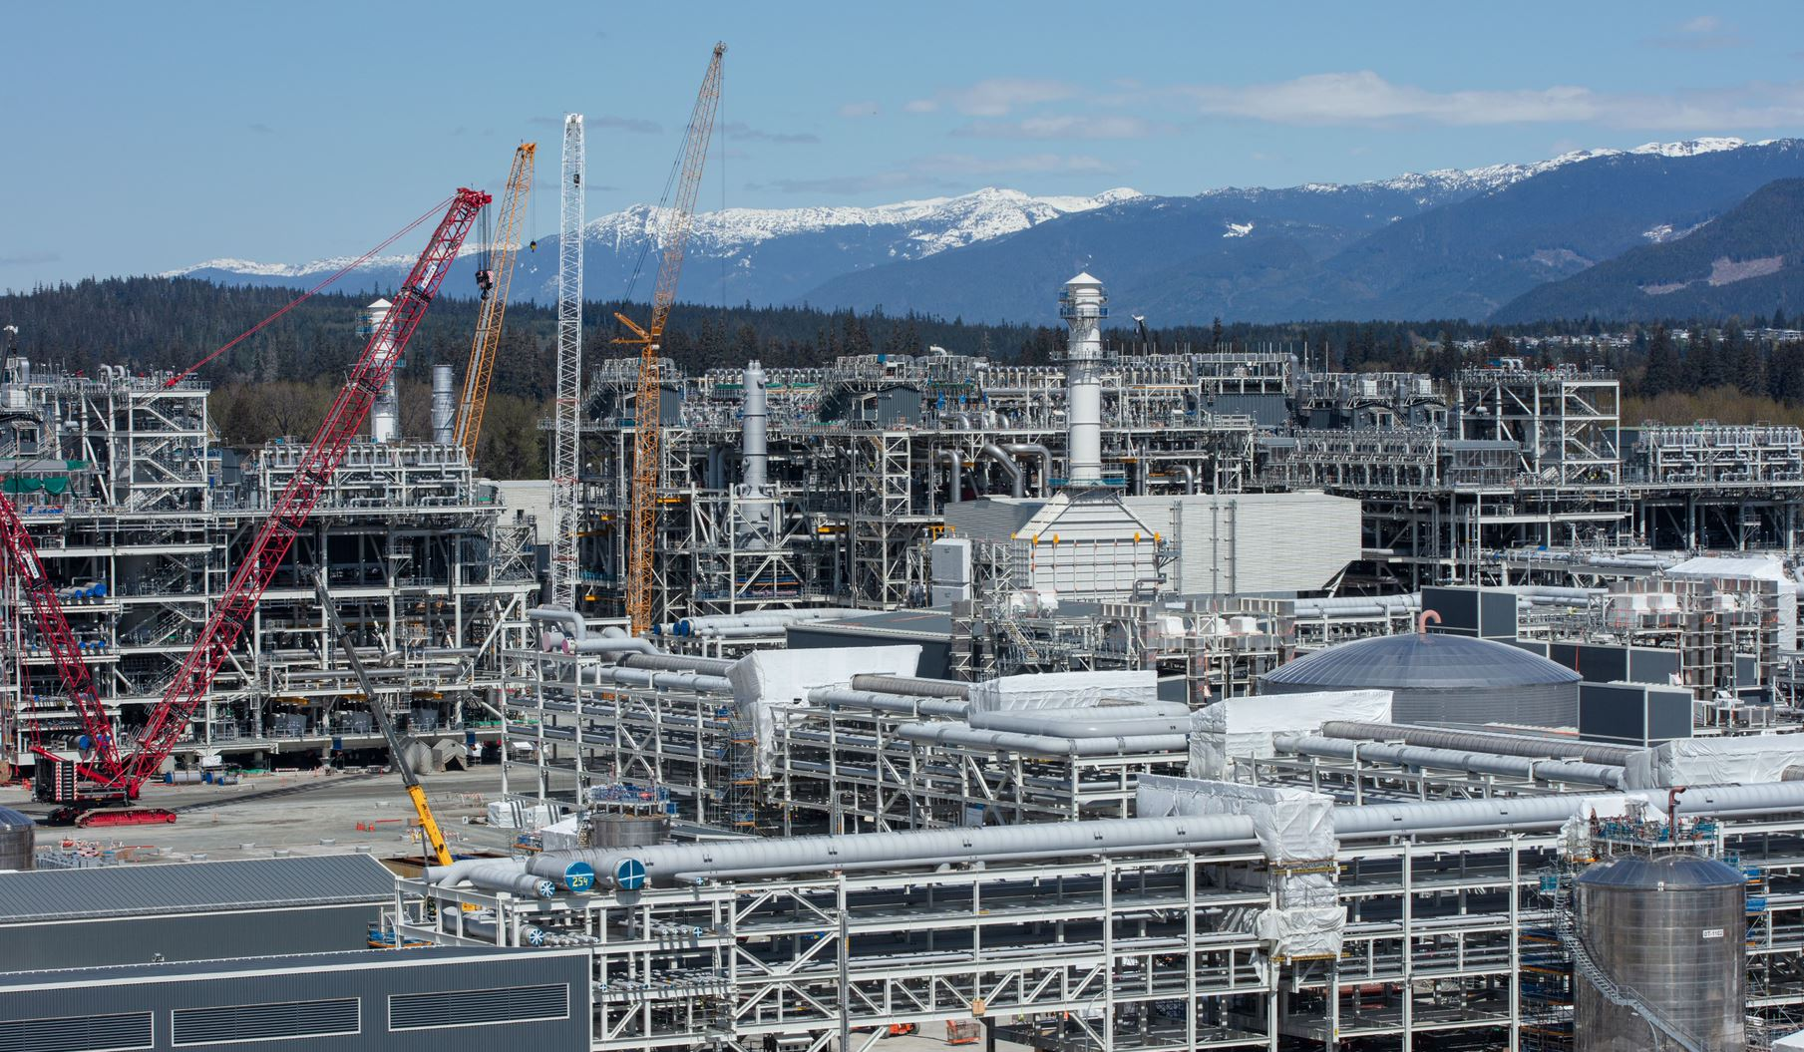
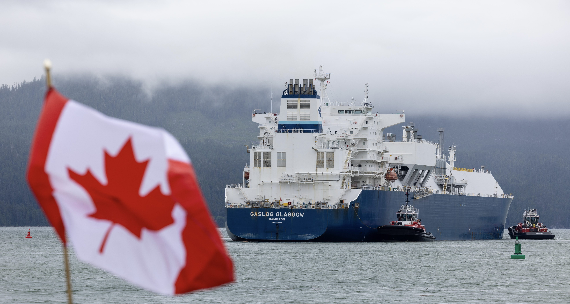
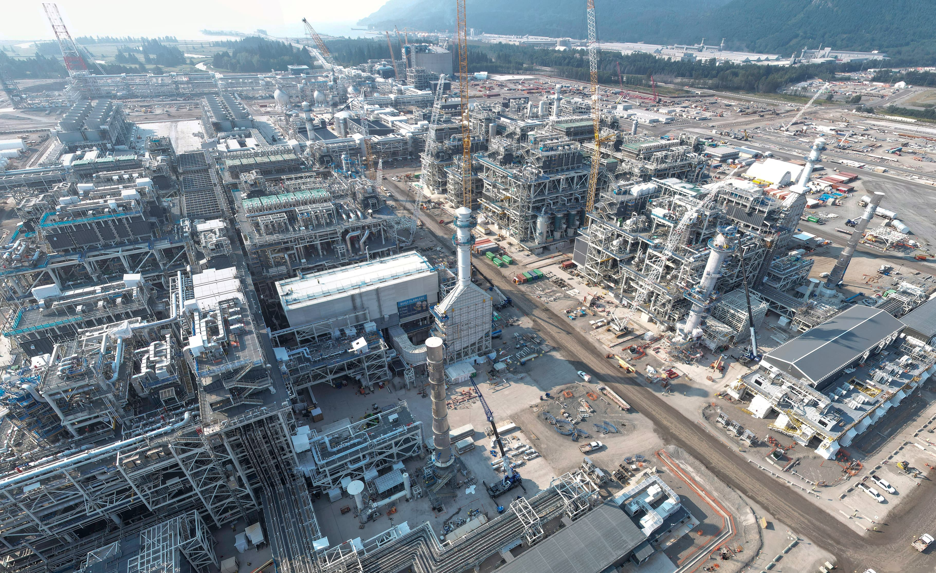
SHAPING GROUP DIRECTION
LNG Canada Phase 2
Developing a frame for a $10+bn integrated opportunity
SHAPE
CONNECT
ACCELERATE
Michiel Yntema and Abhishek Mishra
SCA Global Team F2F 2026 | 7–8 September
Issue Tree and Decision Frame
1A
Market outlook
1
Should Shell invest in LNG capacity in the coming years?
The LNG market will be in sustained oversupply for ~5 years, but demand growth is expected to clear the glut ~ ‘33 without structural resets.
Prices are expected to dip in the short term but revert back to USX LRMC in the long run.
A
What is our market outlook?
Market Conviction
Supply and Demand (MTPA)
JKM price (MOD $/MMBtu)
2
B
Can we afford LNG investment?
Portfolio Affordability
Supply glut
Demand (SEIF)
Is LNGC Phase 2 the right opportunity?
Soft landing
Good glut
RV
A
How competitive is the project?
Project Confidence
Construction
SV
(PSVs are annual averages)
B
Can we deliver conditions for success?
Soft landing
Gloomy glut
C
How does it impact our trading portfolio?
Commercial Thesis
Existing
D
Is the project investable?
2030
2036
2040
2045
2050
2025
2030
2035
2040
E
What alternatives pathways do we have?
Industry demand forecast range
“Good Glut” and “Gloomy Glut” pricing excludes supply response (US shut-ins)
SV includes price floor from US shut-ins and hence appropriate as annual average
2A
Advantaged location
2A
Resilient, low-cost gas
2C
Pacific basin supply
2035 Atlantic
Basin supply
with Ph2
SRMC, Delivered Ex Ship Tokyo Bay, $/mmbtu
without Ph2
7
US LNG range
Others
(18%)
6
LNG Canada
(22%, Ph 1+2)
5
SLMT supply
by country
2035
4
With feed gas opportunity cost
Feed gas cost
USA
(29%)
Western
3
2.6
2
1.2
Capacity (MT)
Shipping + variable Opex
Nigeria
(6%)
Australia
(21%)
1
39%
45%
45%
2035 Pacific
Basin supply
0
LNG Canada
52%
2E
Long cycle vs short cycle investments
2D
Price scenarios and volatility
Two projects with same CAPEX but different CF profiles Comparing short cycle US gas acreage + USX LNG offtake with long cycle LNG Canada Phase 2
Archetype using Range Resources acquisition paired with US LNG offtake1
Market discontinuities¹ expose LNGC Ph2 to ~ 1 $bln p.a. short term upside / downside, while a lifecycle market price at 12.5% Brent can erode 1.8 $bln NPV
LNGC Phase 2 is resilient against price risk due to minimal AECO/JKM cross commodity exposure, with P10 – P90 range driven primarily by JKM price
3
LNGC Phase 2 FCF ($bn)
NPV volatility ($bn)
NPV Scenarios ($bn)
2
13.3% IRR
$2bn NPV
MOD payback 2033
PV payback 2037
Upside discontinuity
RV
P10
$10.1bn
3,818 (base)
1
Prolonged Glut
$5.8bn
HBCIG #1
0
Downside discontinuity
Expected
$3.6bn
HBCIG #2
US Shale + USX (Short Cycle)
FCF ($bn)
P90
$1.4bn
HBCIG #3
-1
HGCIG #1
+2,132
-8
-$1.8bn
-9
12.5% IRR
$3.8bn NPV
MOD payback 2038
PV payback 2045
2C
LNG Industry Country profile and disruption risk
LNGC Ph2 (Long Cycle)
FCF ($bn)
Sales into JKTC (deepest LNG market) enhance absorbability of outages. Industry disruptions in Qatar, US and Australia increase value.
Industry Risk | Australia (11%) | Canada (3%) | Nigeria (3%) | Qatar (20%) | US (39%)
Weather events | Cyclone | Forest fire/rain | Low | Low | Hurricane
Shipping disruptions | Low | Low | Low | Hormuz | Panama
Security | Low | Low | Security | Geopolitical | Low
Feedgas supply risk | Pipeline risks | Pipeline risks | Pipeline risks | Low | Low
Fiscal/Tax | Tax dispute | BAPA | Negotiation | Low | Low
Long-cycle LNG benefits from extended market exposure and portfolio optionality.

